Slide 1
Data Structures
Lecture#3

Slide 2
Types of methods in Python
Instance Method
Class Method
Performs instance specific tasks
The variable inside the instance method is called instance variable
While defining an instance method we don’t use any decorator.
At least one parameter is needed i.e. self
Performs common tasks
Contains class variables
A decorator @classmethod must be used to define a class method
At least one parameter is needed i.e. cls

Slide 3
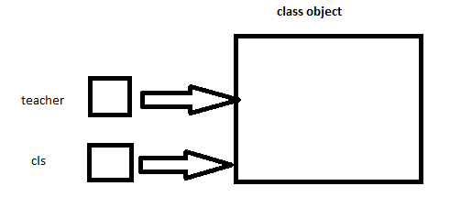
Importance of cls parameter

Slide 4
Instance method
We can not define instance object variable directly within the class body.
We can use instance method to define an instance object variable.
__init__ function is an instance method and works as a constructor.

Slide 5
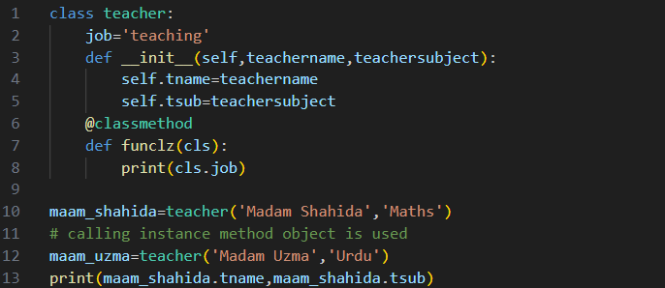
Python Program
Implementation:

Slide 6

Python Program (cont…)
When we run the code teacher.funclz(), it will execute
funclz(teacher)

Slide 7

Python Program (cont…)
Result:

Slide 8
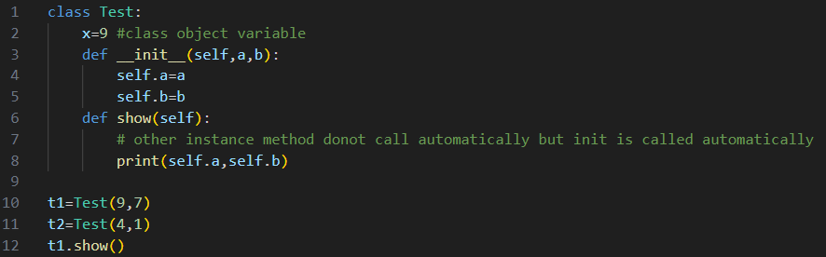

Instance method other than init()

Slide 9
THANK YOU

